Slide 1
Intelligent Parking System
Team Members:
Bhanu Tejaswi Mandadi – 11525449
Anwar Hussain Shaik- 11520286

Slide 2
Agenda
Abstract
Introduction
Project Scope
Methodology
Data Processing
Objectives
Responsibility
Concerns
Conclusion

Slide 3
Abstract
Shrewd urban areas are a consequence of constant mechanical headways pointed toward working on the nature of life for their residents. One of the most crucial aspects of smart cities is urban mobility. Urban traffic congestion is becoming increasingly typical in significant puts as the quantity of vehicles out and about increases. Furthermore, even in vehicle parks, obtaining a parking spot is difficult for drivers who go in circles. According to studies, cars hunting for parking places cause up to 30% of traffic delays. In this case, drivers must be able to forecast the places accessible in parking garages where they wish to park.

Slide 4
Introduction
Observing a phenomenon is a problem that affects people all across the world. parking spot to leave your vehicle. This assignment looks straightforward on side streets and inside paths however the genuine issue emerges while leaving in shopping centers, multistory leaving structures, IT centre points, and departing workplaces with a few hundred automobiles, it becomes a problem. exhausting to track down a spot. The general way to deal with observing a parking spot is to go around and drive carelessly until a free space is found. Observing a parking spot could be the least requesting undertaking or could be the most dreary one when it includes wide sections of land of appropriated space across one level or different levels.

Slide 5
Project Scope
Adopting of automatic Intelligent parking system so that availability of space could be known and enhanced security.
Intelligent car parking save time and fuel, reducing the environmental pollution.

Slide 6
Methodology
The intelligent parking system is an intelligent stopping framework that utilizes a location gadget to characterize the inhabitance pace of the parking spot. It assists the driver in parking safely and notifies him or her of available parking spaces. through appropriate vehicle management. Thanks to intelligent technologies, optimized parking can reach the city center. A sensor system indicating to drivers where the closest free parking spot is located has already been put to the test. multi-storey car parks.

Slide 7
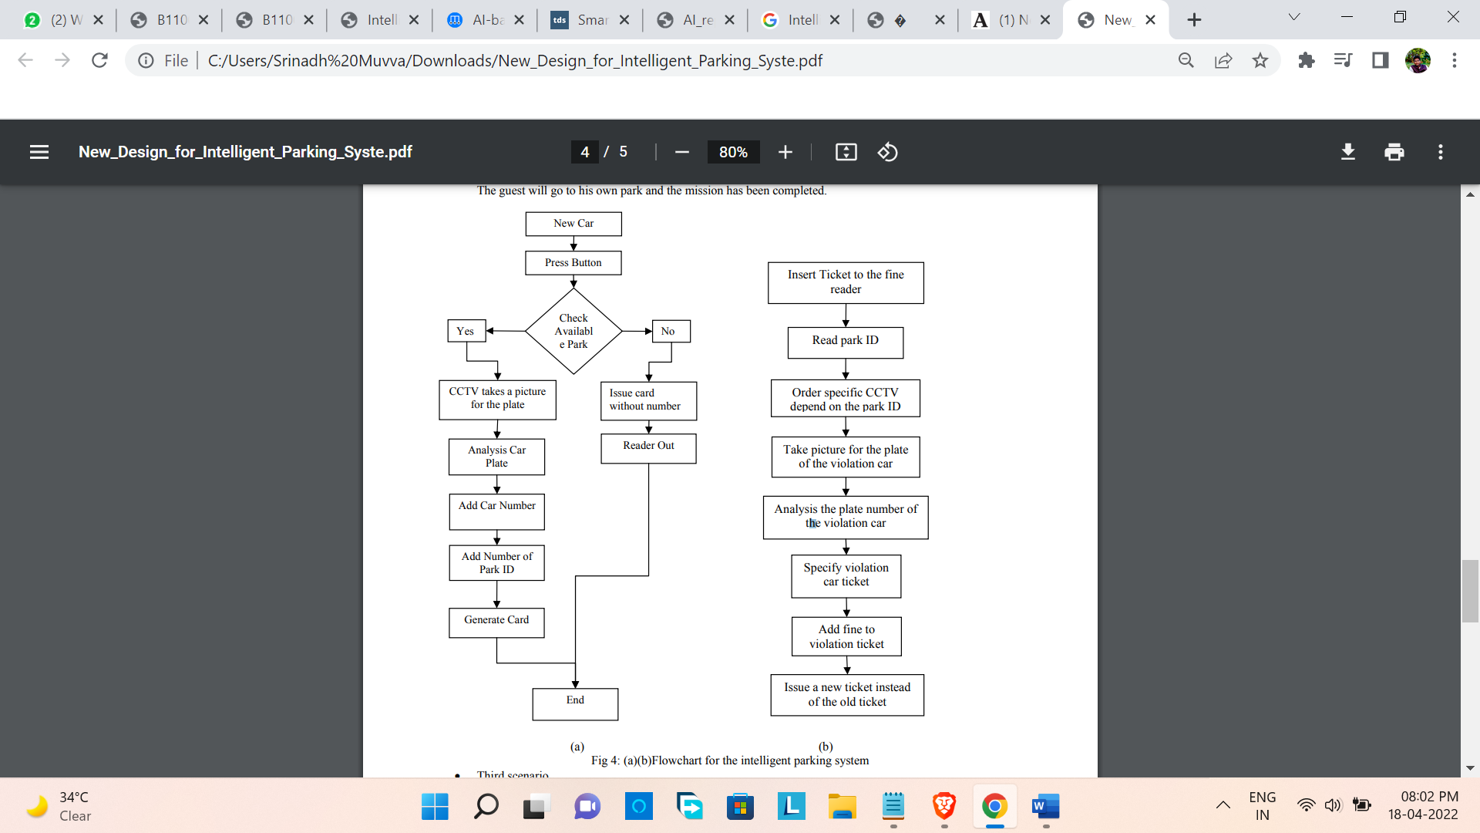
Data Processing

Slide 8
Objectives
To develop an user friendly automated car parking framework which diminishes the labor and time saving.
To offer a safe space and secure parking slots with in limited area.
To reduce traffic mess caused by an unplanned parking system.

Slide 9
Responsibility
This always developing gridlock and vulnerability in the stopping accessibility and installment have accordingly authorized the requirement for an Intelligent stopping framework. An Intelligent stopping framework innovation that will assist with upgrading parking spot utilization, work on the proficiency of the stopping activities, and assist smoother with dealing stream.

Slide 10
Concerns
The problem with our clever parking systems is that they don't have enough space. Wide range of hardware and software involved in implementing our system in the best way. It also involves more computing power and resource.
People need to take care of themselves by considering the other people while parking in the desired parking slot. Human assistance is also required to run these systems more efficiently.

Slide 11
Conclusion
The framework is made more productive as vehicle travel time and search time are essentially diminished because of the data given by the brilliant leaving framework. With the data gave, drivers can stay away from vehicle leave that are completely involved and find empty parking spots easily somewhere else

Slide 12
Thank You

